Slide 1
APPLETS

Slide 2
Applets are small applications that are accessed on an Internet server, transported over the Internet, automatically installed, and run as part of a Web document
After an applet arrives on the client, it has limited access to resources, so that it can produce an arbitrary multimedia user interface and run complex computations without introducing the risk of viruses or breaching data integrity.

Slide 3
import java.awt.*;
import java.applet.*;
public class SimpleApplet extends Applet {
public void paint(Graphics g) {
g.drawString("A Simple Applet", 20, 20);
} }
Applets interact with the user through the AWT, Abstract Window Toolkit) not through the console-based I/O classes. The AWT contains support for a window-based, graphical interface.
The second import statement imports the applet package, which contains the class Applet.

Slide 4
Inside paint( ) is a call to drawString( ), which is a member of the Graphics class. This method outputs a string beginning at the specified X,Y location. It has the following general form:
void drawString(String message, int x, int y)
The applet does not have a main( ) method. Unlike Java programs, applets do not begin execution at main( ).
An applet begins execution when the name of its class is passed to an applet viewer or to a network browser.
Compile in the same way that you have been compiling programs.

Slide 5
Two ways in which you can run an applet:
Executing the applet within a Java-compatible Web browser.
Using an applet viewer, such as the standard SDK tool, appletviewer. An applet viewer executes your applet in a window.
To execute an applet in a Web browser, you need to write a short HTML text file that contains the appropriate APPLET tag.
Type this in RunApp.html file
<applet code="SimpleApplet" width=200 height=60>
</applet>

Slide 6
To execute SimpleApplet with an applet viewer, you may also execute the HTML file shown earlier. For example, if the preceding HTML file is called RunApp.html, then the following command line will run SimpleApplet:
C:\>appletviewer RunApp.html
In general, you can quickly iterate through applet development by using these three steps:
1. Edit a Java source file.
2. Compile your program.
3. Execute the applet viewer, specifying the name of your applet’s source file. The applet viewer will encounter the APPLET tag within the comment and execute your applet.

Slide 7
Applets do not need a main( ) method.
Applets must be run under an applet viewer or a Java-compatible browser.
User I/O is not accomplished with Java’s stream I/O classes. Instead, applets use the interface provided by the AWT.
The Applet Class
Applet provides all of the necessary support for window-based activities ( methods that load and display images, load and display audio clips). Applet extends panel, extends container, extends component.
Methods defined by applet follows:

Slide 8
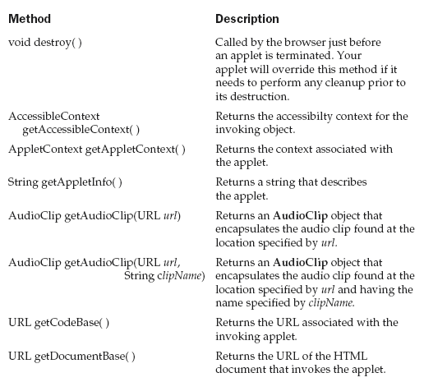

Slide 9
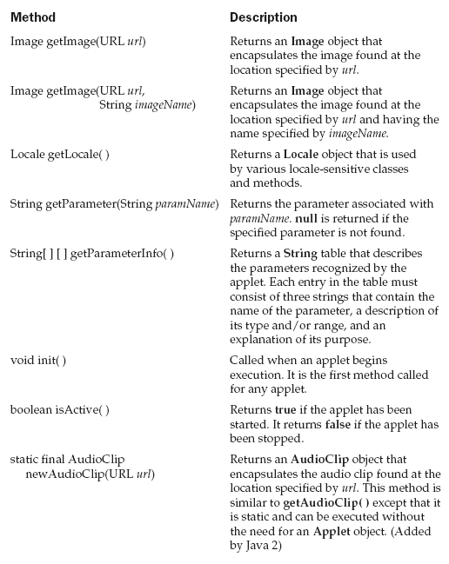

Slide 10
Applet Architecture
An applet is a window-based program
First, Applets are event driven; An applet waits until an event occurs
The AWT notifies the applet about an event by calling an event handler that has been provided by the applet
Once this happens, the applet must take appropriate action and then quickly return control to the AWT

Slide 11
Second, the user initiates interaction with an applet—not the other way around (non-window based programs)
The user interacts with the applet as he or she wants. These interactions are sent to the applet as events to which the applet must respond
For example, when the user clicks a mouse inside the applet’s window, a mouse-clicked event is generated
When the user interacts with one of these controls, an event is generated.

Slide 12
An Applet Skeleton
All but the most trivial applets override a set of methods that provides the basic mechanism by which the browser or applet viewer interfaces to the applet and controls its execution.
Four of these methods—init( ), start( ), stop( ), and destroy( )—are defined by Applet.
Another, paint( ), is defined by the AWT Component class.
Default implementations for all of these methods are provided. Applets do not need to override those methods they do not use.

Slide 13
// An Applet skeleton.
import java.awt.*;
import java.applet.*;
/* <applet code="AppletSkel" width=300 height=100> </applet> */
public class AppletSkel extends Applet {
// Called first.
public void init() {
// initialization
}
/* Called second, after init(). Also called whenever the applet is restarted. */
public void start() {
// start or resume execution
}

Slide 14
// Called when the applet is stopped.
public void stop() {
// suspends execution
}
/* Called when applet is terminated. This is the last method executed. */
public void destroy() {
// perform shutdown activities
}
// Called when an applet's window must be restored.
public void paint(Graphics g) {
// redisplay contents of window
}
}

Slide 15
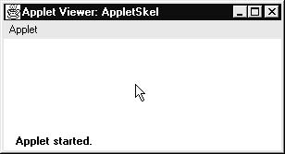
Although this skeleton does not do anything, it can be compiled and run. When run, it generates the following window when viewed with an applet viewer:

Slide 16
When an applet begins, the AWT calls the following methods, in this sequence:
1. init( )
2. start( )
3. paint( )
When an applet is terminated, the following sequence of method calls takes place:
1. stop( )
2. destroy( )

Slide 17
init( ) method
The init( ) method is the first method to be called
This is where we should initialize variables
This method is called only once during the run time of the applet.

Slide 18
start ( ) method
The start( ) method is called after init( )
It is also called to restart an applet after it has been stopped
Whereas init( ) is called once - the first time an applet is loaded - start( ) is called each time an applet’s HTML document is displayed onscreen
So, if a user leaves a web page and comes back, the applet resumes execution at start( )

Slide 19
paint ( ) method
The paint( ) method is called each time your applet’s output must be redrawn
This situation can occur for several reasons
The window in which the applet is running can be overwritten by another window and then uncovered
Or, the applet window can be minimized and then restored
paint( ) is also called when the applet begins execution
The paint( ) method has one parameter of type Graphics
This parameter contains the graphics context, which describes the graphics environment in which the applet is running

Slide 20
stop( ) method
The stop( ) method is called when a web browser leaves the HTML document containing the applet - when it goes to another page, for example.
When stop( ) is called, the applet is probably running
You should use stop( ) to suspend threads that don’t need to run when the applet is not visible
You can restart them when start( ) is called if the user returns to the page

Slide 21
destroy( ) method
The destroy( ) method is called when the environment determines that your applet needs to be removed completely from memory
At this point, you should free up any resources the applet may be using
The stop( ) method is always called before destroy( )

Slide 22
Overriding update( )
In some situations, your applet may need to override another method defined by the AWT, called update( ). This method is called when your applet has requested that a portion of its window be redrawn.
The default version of update( ) first fills an applet with the default background color and then calls paint( ).
If you fill the background using a different color in paint( ), the user will experience a flash of the default background each time update( ) is called—that is, whenever the window is repainted.
override the update( ) method so that it performs all necessary display activities. Then have paint( ) simply call update( ). Thus, for some applications, the applet skeleton will override paint( ) and update( ), as shown here:
public void update(Graphics g) {
// redisplay your window, here. }
public void paint(Graphics g) {
update(g); }

Slide 23
Simple Applet Display Methods
To output a string to an applet, use drawString( ), which is a member of the Graphics class
void drawString(String message, int x, int y)
Here, message is the string to be output beginning at x,y

Slide 24
The drawString( ) method will not recognize newline characters
If you want to start a line of text on another line, you must do so manually, specifying the precise X,Y location where you want the line to begin
To set the background color of an applet’s window, use setBackground( ). To set the foreground color (the color in which text is shown), use setForeground( ).
These methods are defined by Component, and they have the following general forms:

Slide 25
void setBackground(Color newColor)
void setForeground(Color newColor)
The class Color defines the constants that can be used to specify colors
Color.black Color.magenta
Color.blue Color.orange
Color.cyan Color.pink
Color.darkGray Color.red
Color.gray Color.white
Color.green Color.yellow
Color.lightGray

Slide 26
Examples to set foreground and background:
setBackground(Color.green);
setForeground(Color.red);
Color getBackground( )
Color getForeground( )
Example program:
import java.awt.*;
import java.applet.*;
/* <applet code="Sample" width=300 height=50>
</applet> */
public class Sample extends Applet{
String msg;

Slide 27
// set the foreground and background colors.
public void init() {
setBackground(Color.cyan);
setForeground(Color.red);
msg = "Inside init( ) --";
}
// Initialize the string to be displayed.
public void start() {
msg += " Inside start( ) --";
}
// Display msg in applet window.
public void paint(Graphics g) {
msg += " Inside paint( ).";
g.drawString(msg, 10, 30);
} }

Slide 28
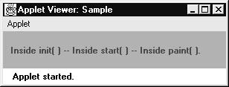
This applet generates the window shown here:

Slide 29
Requesting Repainting
An applet writes to its window only when its update( ) or paint( ) method is called by the AWT
an applet must quickly return control to the AWT run-time system. It cannot create a loop inside paint( ) to scroll
Whenever your applet needs to update the information displayed in its window, it simply calls repaint( )

Slide 30
The repaint( ) method has four forms:
void repaint( ) - Causes the entire window to be repainted
void repaint(int left, int top, int width, int height)
- The coordinates of the upper-left corner of the region are specified by left and top, and the width and height of the region are passed in width and height.
- These dimensions are specified in pixels
-You save time by specifying a region to repaint .
- If you need to update only a small portion of the window, it is more efficient to repaint only that region.

Slide 31
if your system is slow or busy, update( ) might not be called immediately. Multiple requests for repainting that occur within a short time can be collapsed by the AWT in a manner such that update( ) is only called sporadically. This can be a problem in many situations, including animation, in which a consistent update time is necessary. One solution to this problem is to use the following forms of repaint( ):
void repaint(long maxDelay)
void repaint(long maxDelay, int x, int y, int width, int height)
Here, maxDelay specifies the maximum number of milliseconds that can elapse before update( ) is called

Slide 32
/* A simple banner applet.
This applet creates a thread that scrolls
the message contained in msg right to left
across the applet's window.
*/
import java.awt.*;
import java.applet.*;
/*
<applet code="SimpleBanner" width=300 height=50>
</applet>
*/

Slide 33
public class SimpleBanner extends Applet implements Runnable {
String msg = " A Simple Moving Banner.";
Thread t = null;
int state;
boolean stopFlag;
public void init() { // Set colors and initialize thread.
setBackground(Color.cyan);
setForeground(Color.red);
}
public void start() { // Start thread
t = new Thread(this);
stopFlag = false;
t.start();
}

Slide 34
// Entry point for the thread that runs the banner.
public void run() {
char ch;
// Display banner
for( ; ; ) {
try {
repaint();
Thread.sleep(250);
ch = msg.charAt(0);
msg = msg.substring(1, msg.length());
msg += ch;
if(stopFlag)
break;
} catch(InterruptedException e) {}
} }

Slide 35
// Pause the banner.
public void stop() {
stopFlag = true;
t = null;
}
// Display the banner.
public void paint(Graphics g) {
g.drawString(msg, 50, 30);
}
}

Slide 36
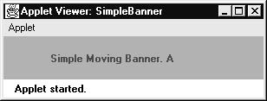
Following is sample output:

Slide 37
SimpleBanner extends Applet, but it also implements Runnable. This is necessary, since the applet will be creating a second thread of execution that will be used to scroll the banner.
Inside init( ), the foreground and background colors of the applet are set.
After initialization, the AWT run-time system calls start( ) to start the applet running. Inside start( ), a new thread of execution is created and assigned to the Thread variable t.
Then, the boolean variable stopFlag, which controls the execution of the applet, is set to false. Next, the thread is started by a call to t.start( ).
t.start( ) and start() of Applet are different methods.

Slide 38
Inside run( ), the characters in the string contained in msg are repeatedly rotated left.
Between each rotation, a call to repaint( ) is made. This eventually causes the paint( ) method to be called and the current contents of msg is displayed. Between each iteration, run( ) sleeps for a quarter of a second. The net effect of run( ) is that the contents of msg is scrolled right to left in a constantly moving display. The stopFlag variable is checked on each iteration. When it is true, the run( ) method terminates.
If a browser is displaying the applet when a new page is viewed, the stop( ) method is called, which sets stopFlag to true, causing run( ) to terminate. When the applet is brought back into view, start( ) is once again called, which starts a new thread to execute the banner.

Slide 39
Using the Status Window
An applet can also output a message to the status window of the browser or applet viewer on which it is running
To do so, call showStatus( ) with the string that you want displayed
The status window is a good place to give the user feedback about what is occurring in the applet, suggest options, or report errors.
The status window also makes an excellent debugging aid, because it gives you an easy way to output information about your applet.

Slide 40
// Using the Status Window.
import java.awt.*;
import java.applet.*;
/*
<applet code="StatusWindow" width=300 height=50>
</applet> */
public class StatusWindow extends Applet{
public void init() {
setBackground(Color.cyan);
}
// Display msg in applet window.
public void paint(Graphics g) {
g.drawString("This is in the applet window.", 10, 20);
showStatus("This is shown in the status window.");
} }

Slide 41
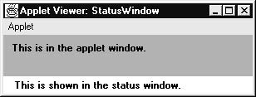
Sample output from this program is shown here:

Slide 42
The HTML APPLET Tag
The APPLET tag is used to start an applet from both an HTML document and from an applet viewer
An applet viewer will execute each APPLET tag that it finds in a separate window, while web browsers like Netscape Navigator, Internet Explorer, and HotJava will allow many applets on a single page

Slide 43
< APPLET
[CODEBASE = codebaseURL]
CODE = appletFile
[ALT = alternateText]
[NAME = appletInstanceName]
WIDTH = pixels HEIGHT = pixels
[ALIGN = alignment]
[VSPACE = pixels] [HSPACE = pixels] >
[< PARAM NAME = AttributeName VALUE = AttributeValue>]
[< PARAM NAME = AttributeName2 VALUE = AttributeValue>] . . .
[HTML Displayed in the absence of Java]
</APPLET>

Slide 44
CODEBASE
Is an optional attribute that specifies the base URL of the applet code, which is the directory that will be searched for the applet’s executable class file (specified by the CODE tag)
CODE
Is a required attribute that gives the name of the file containing your applet’s compiled .class file. This file is relative to the code base URL of the applet

Slide 45
ALT
Is an optional attribute used to specify a short text message that should be displayed if the browser understands the APPLET tag but can’t currently run Java applets
NAME
NAME is an optional attribute used to specify a name for the applet instance
Applets must be named in order for other applets on the same page to find them by name and communicate with them. To obtain an applet by name, use
getApplet( )

Slide 46
WIDTH AND HEIGHT
WIDTH and HEIGHT are required attributes that give the size (in pixels) of the applet display area
ALIGN
ALIGN is an optional attribute that specifies the alignment of the applet
This attribute is treated the same as the HTML IMG tag with these possible values: LEFT, RIGHT, TOP, BOTTOM, MIDDLE, BASELINE, TEXTTOP, ABSMIDDLE, and ABSBOTTOM

Slide 47
VSPACE AND HSPACE
These attributes are optional
VSPACE specifies the space, in pixels, above and below the applet
HSPACE specifies the space, in pixels, on each side of the applet

Slide 48
PARAM NAME AND VALUE
The PARAM tag allows you to specify appletspecific arguments in an HTML page
Applets access their attributes with the getParameter( ) method
[HTML Displayed in the absence of Java]

Slide 49
Passing Parameters to Applets
the APPLET tag in HTML allows us to pass parameters to the applet
To retrieve a parameter, use the getParameter( ) method
It returns the value of the specified parameter in the form of a String object
For numeric and boolean values, you will need to convert their string representations into their internal formats

Slide 50
// Use Parameters
import java.awt.*;
import java.applet.*;
/* <applet code="ParamDemo" width=300 height=80>
<param name=fontName value=Courier>
<param name=fontSize value=14>
<param name=leading value=2>
<param name=accountEnabled value=true>
</applet> */
public class ParamDemo extends Applet{
String fontName;
int fontSize;
float leading;
boolean active;

Slide 51
// Initialize the string to be displayed.
public void start() {
String param;
fontName = getParameter("fontName");
if(fontName == null)
fontName = "Not Found";
param = getParameter("fontSize");
try {
if(param != null) // if not found
fontSize = Integer.parseInt(param);
else
fontSize = 0;
} catch(NumberFormatException e) {
fontSize = -1;
}

Slide 52
param = getParameter("leading");
try {
if(param != null) // if not found
leading = Float.valueOf(param).floatValue();
else
leading = 0;
} catch(NumberFormatException e) {
leading = -1;
}
param = getParameter("accountEnabled");
if(param != null)
active = Boolean.valueOf(param).booleanValue();
}
// Display parameters.

Slide 53
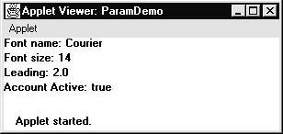
public void paint(Graphics g) {
g.drawString("Font name: " + fontName, 0, 10);
g.drawString("Font size: " + fontSize, 0, 26);
g.drawString("Leading: " + leading, 0, 42);
g.drawString("Account Active: " + active, 0, 58);
}
}
Uncaught exceptions should never occur within an applet.

Slide 54
// A parameterized banner
import java.awt.*;
import java.applet.*;
/*<applet code="ParamBanner" width=300 height=50>
<param name=message value="Java makes the Web move!">
</applet> */
public class ParamBanner extends Applet implements Runnable {
String msg;
Thread t = null;
int state;
boolean stopFlag;
// Set colors and initialize thread.
public void init() {
setBackground(Color.cyan);

Slide 55
setForeground(Color.red);
}
public void start() { // Start thread
msg = getParameter("message");
if(msg == null) msg = "Message not found.";
msg = " " + msg;
t = new Thread(this);
stopFlag = false;
t.start();
} // Entry point for the thread that runs the banner.
public void run() {
char ch;
// Display banner
for( ; ; ) {

Slide 56
try { repaint();
Thread.sleep(250);
ch = msg.charAt(0);
msg = msg.substring(1, msg.length());
msg += ch;
if(stopFlag)
break;
} catch(InterruptedException e) {}
} } // Pause the banner.
public void stop() {
stopFlag = true;
t = null; } // Display the banner.
public void paint(Graphics g) {
g.drawString(msg, 50, 30);
} }

Slide 57
getDocumentBase( ) and getCodeBase( )
Java will allow the applet to load data from the directory holding the HTML file that started the applet (the document base) and the directory from which the applet’s class file was loaded (the code base)

Slide 58
import java.awt.*;
import java.applet.*;
import java.net.*;
/*
<applet code="Bases" width=300 height=50>
</applet>
*/
public class Bases extends Applet{
// Display code and document bases.
public void paint(Graphics g) {
String msg;
URL url = getCodeBase(); // get code base
msg = "Code base: " + url.toString();
g.drawString(msg, 10, 20);

Slide 59
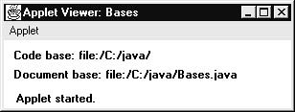
url = getDocumentBase(); // get document base
msg = "Document base: " + url.toString();
g.drawString(msg, 10, 40);
}
}

Slide 60
AppletContext and showDocument( )
To allow the applet to transfer control to another URL, we must use the showDocument( ) method defined by the AppletContext interface
AppletContext is an interface that lets us get information from the applet’s execution environment
The context of the currently executing applet is obtained by a call to the getAppletContext( ) method defined by Applet

Slide 61
Within an applet, once you have obtained the applet’s context, you can bring another document into view by calling showDocument( )
This method has no return value and throws no exception if it fails
There are two showDocument( ) methods
The method showDocument(URL) displays the document at the specified URL

Slide 62
The method showDocument(URL, where) displays the specified document at the specified location within the browser window
Valid arguments for where are “_self” (show in current frame), “_parent” (show in parent frame), “_top” (show in topmost frame), and “_blank” (show in new browser window)

Slide 63
import java.awt.*;
import java.applet.*;
import java.net.*;
/*
<applet code="ACDemo" width=300 height=50>
</applet>
*/
public class ACDemo extends Applet{
public void start() {
AppletContext ac = getAppletContext();
URL url = getCodeBase(); // get url of this applet
try {
ac.showDocument(new URL(url+"Test.html"));
} catch(MalformedURLException e) {
showStatus("URL not found");
} } }

Slide 64
The AudioClip Interface
The AudioClip interface defines these methods: play( ) (play a clip from the beginning), stop( ) (stop playing the clip), and loop( ) (play the loop continuously)
After you have loaded an audio clip using getAudioClip( ), you can use these methods to play it

Slide 65
Outputting to the Console
It is possible to use console output in the applet—especially for debugging purposes
In an applet, when you call a method such as System.out.println( ), the output is not sent to your applet’s window
Instead, it appears either in the console session in which you launched the applet viewer

